Slide 1
Internet & Web
Lab 11: Web Browser, Protocol, Search Engine.

Slide 2


Welcome to Internet & Web Class

Slide 3

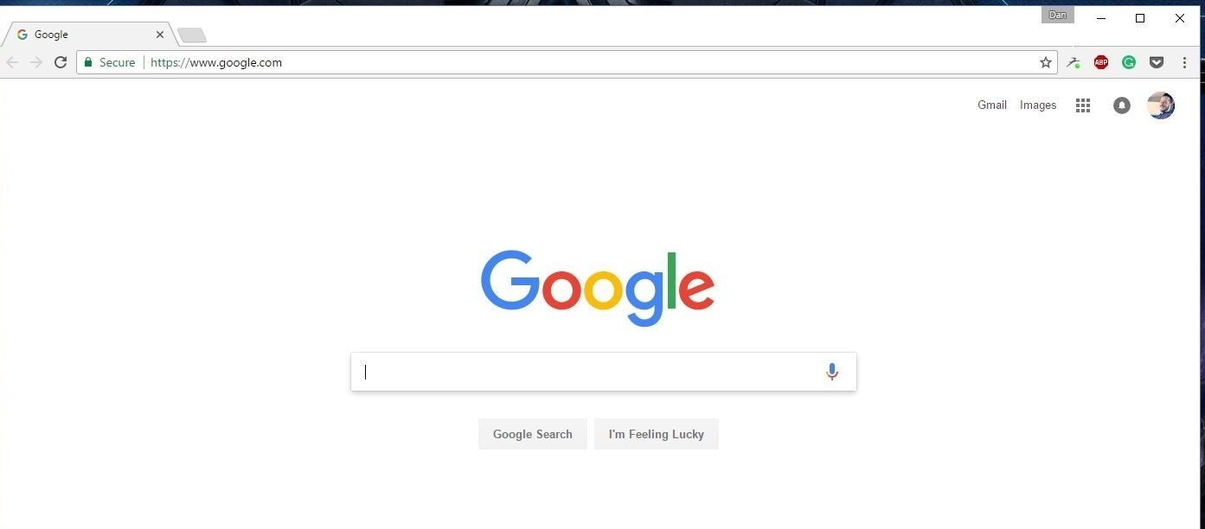
What is Web Browser?
A web browser (commonly referred to as a browser) is a software application for accessing information on the World Wide Web.
Browsers translate web pages and websites delivered
using Hypertext Transfer Protocol (HTTP) into human
readable content.

Slide 4
Browsers' benefits and key features
They're free to download.
You can have more than one on your computer.
They all work in a similar way.
They allow users to explore websites anywhere on the internet.
Can be personalized by allowing users to add favorites or set a different home page (the first page that you see when you open your browser).

Slide 5
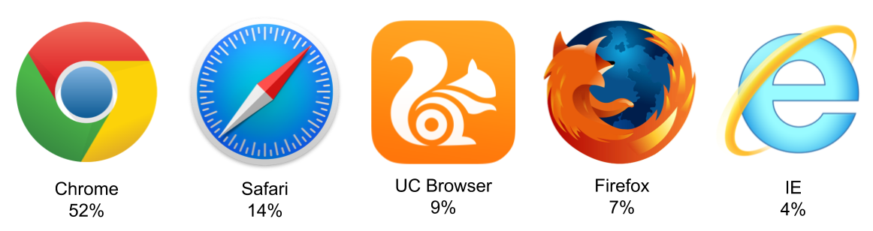
Browser Examples
Google Chrome
Apple Safari
UC Browser
Mozilla Firefox
Internet Explorer

Slide 6
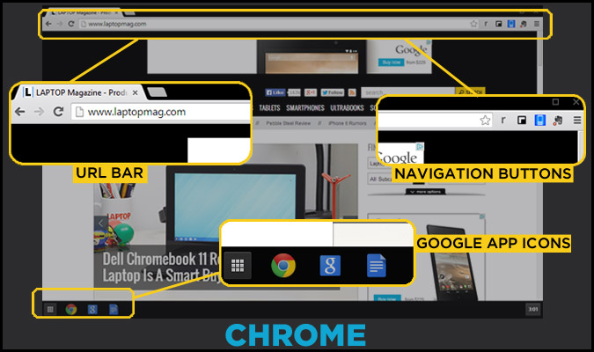
Chrome Browser Interface

Slide 7
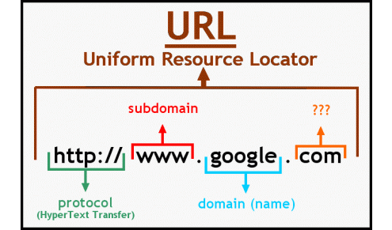
What is URL?
URL stands for Uniform Resource Locator, and is used to specify addresses on the World Wide Web.

Slide 8

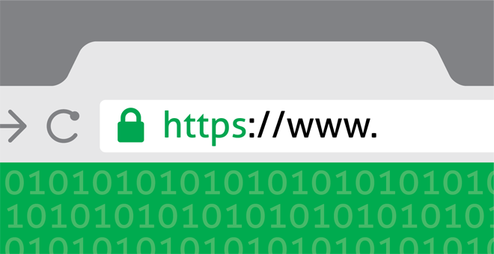
Web Protocol
HTTP
HTTPS
Hypertext Transfer Protocol
Hypertext Transfer Protocol over Secure Socket Layer

Slide 9
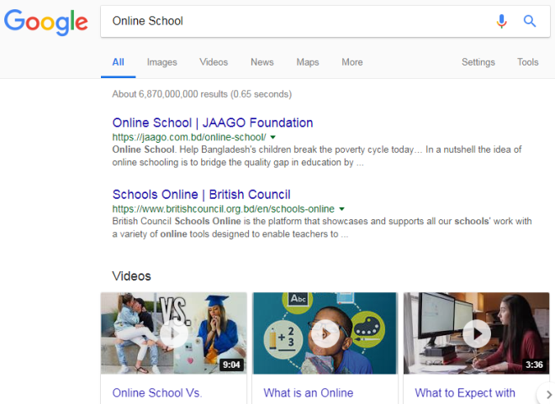
Search Engine
A service that allows Internet users to search for content via the WWW
Some Popular Search Engine:
Google. (www.google.com)
Bing. (www.bing.com)
Duck Duck Go. (www. DuckDuckGo.com)
Yahoo (www.Yahoo.com)

Slide 10

Today’s learning:
Web Browser
Web Protocol
Search Engine.
Thank You!

